Slide 1
Anti-Corruption and Shareholder Valuations:
Event Study Evidence from China
Author: Chen Lin, Randall Morck, Bernard Yeung, Xiaofeng Zhao
Speaker: Qi Zhou (Tracy)

Slide 2
CONTENTS
01
Background
02
Methodology
and Data
03
Empirical
Findings
04
Conclusion &
Final Thoughts

Slide 3
01
Background

Slide 4
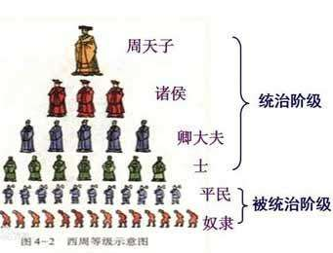
1.1 Corruption in China
The Eight-point Regulation
Feudal Culture
Large power distance
Communist Party of China
Artful Connection
Socialist egalitarianism
Serve for the people
Company and government study
Corruption
Corruption differs among SOEs and non-SOEs

Slide 5
1.2 The Eight-point Regulation on Dec.4 2012
Leaders must keep in close contact with the grassroots, but without inspection tours or formality.
Leaders traveling by car must avoid disrupting traffic
Meetings and major events are to be strictly regulated and efficiently arrange, and empty grand gestures are to be avoided.
Media stories about official events are to be limited to events with real news value.
Government leaders should not publish self-authored works or congratulatory letters.
The issuance of official documents must be reduced
Leaders must practice thrift and strictly obey regulations regarding accommodation and cars.
Overseas official visits and related formalities are to be restricted

Slide 6
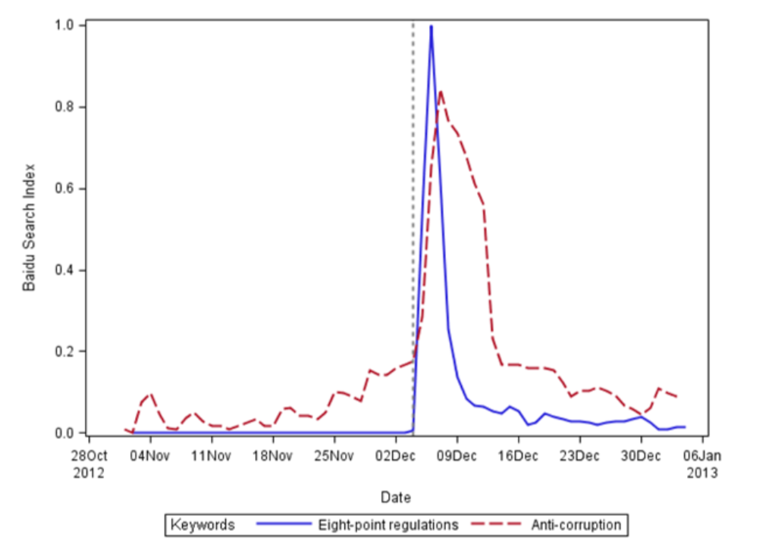
Figure 1:
Online Attention on the Eight-point Regulation

Slide 7
Effect of the Eight-point Regulation
Punishment on Officials including Party Cadres
01
In 2013, 182,000 were punished for corruption and abuse of power nationwide, 30,420 party cadres were punished specially for the regulation, with at least 227 being province-level or higher. The punishment continues after that.
Commodity Market
02
Sales of cigarettes, alcohol, shark fins, edible swallows, Gucci bags and Ferraris dropped abruptly in 2013.
03
Decrease of ETC Ratio
Figure 2
Relatively high raw return
on Chinese stock market portfolio
04

Slide 8
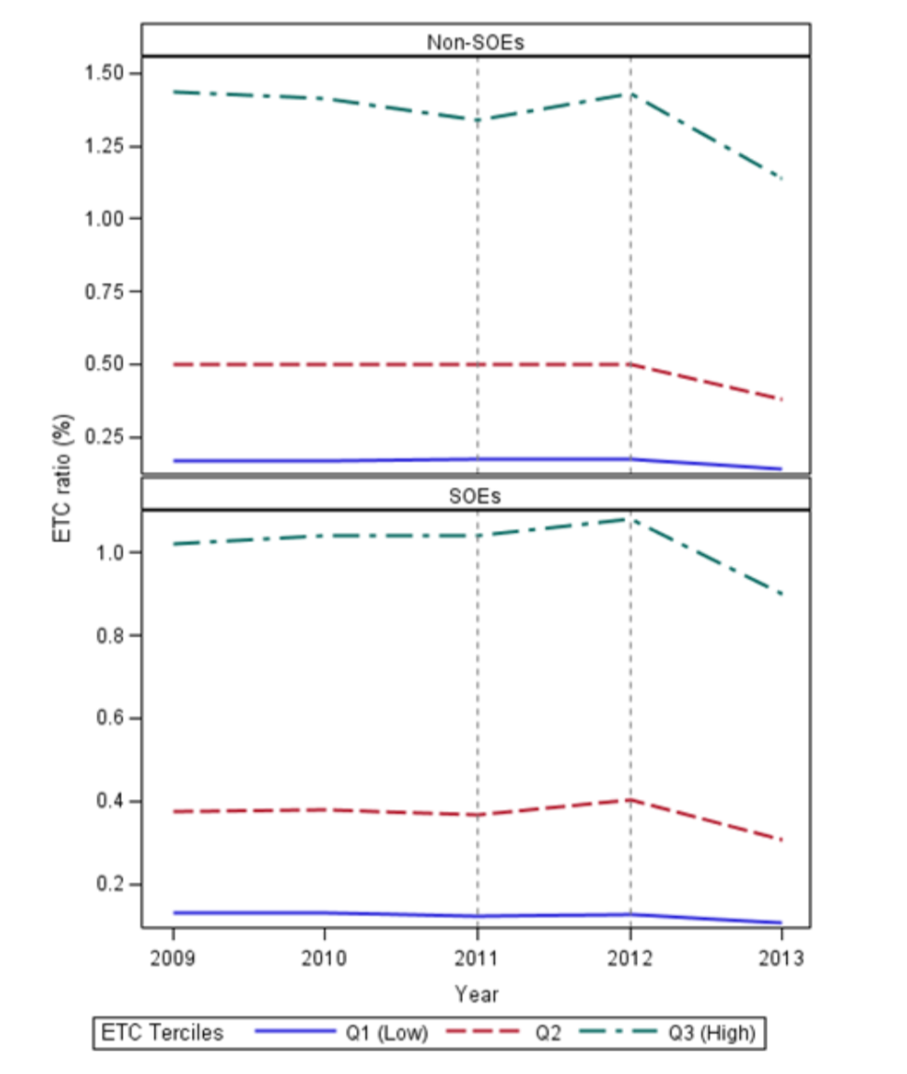
Figure 2:
Entertainment and Travel Costs Ratio
Before and After the Announcement
Back

Slide 9
02
Methodology and Data

Slide 10
2.1 Modified Event Study Methodology
Calculate the market portfolio’s raw return on and around the event date
Compare the returns of portfolios of firms in different provinces or under different circumstances
Run regressions explaining firm-level raw returns or cumulative abnormal returns with firm characteristics
Cluster standard errors both by industry and by province to mitigate overstating statistical significance

Slide 11
2.2 Data and Variables
All firms listed on China’s two stock exchanges
Likely past investment in official connections
ETC from WIND
Institution environment (province-level marketization index)
Resource allocation subindex
State-owned?
Financial sector marketization subindex
Legal environment subindex
30% threshold directly or indirectly

Slide 12
03
Empirical Findings

Slide 13
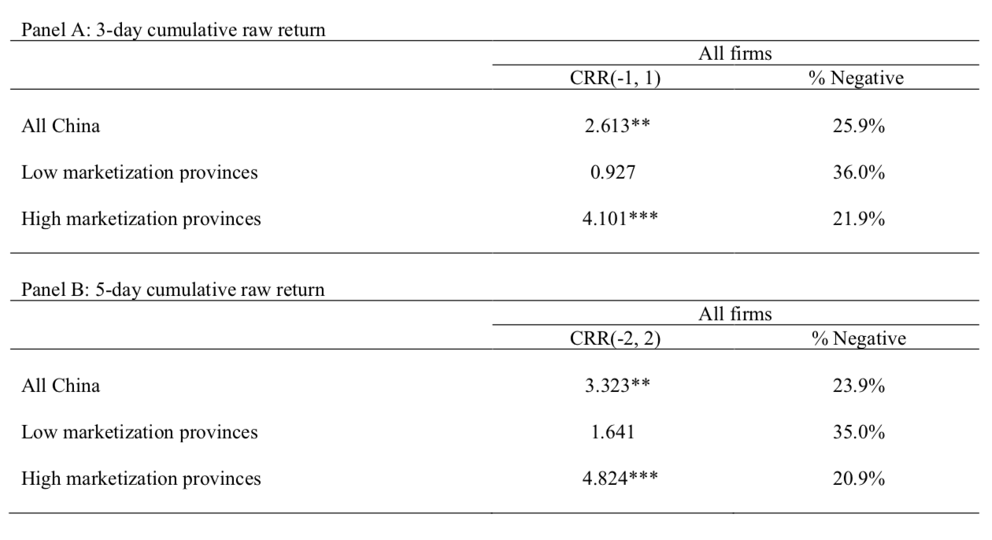
3.1 Overall Reaction
Figure 3: Stock Market Reaction and Differentiate by marketization

Slide 14
3.2 Location and marketization
Figure 3: Stock Market Reaction and Differentiate by marketization

Slide 15
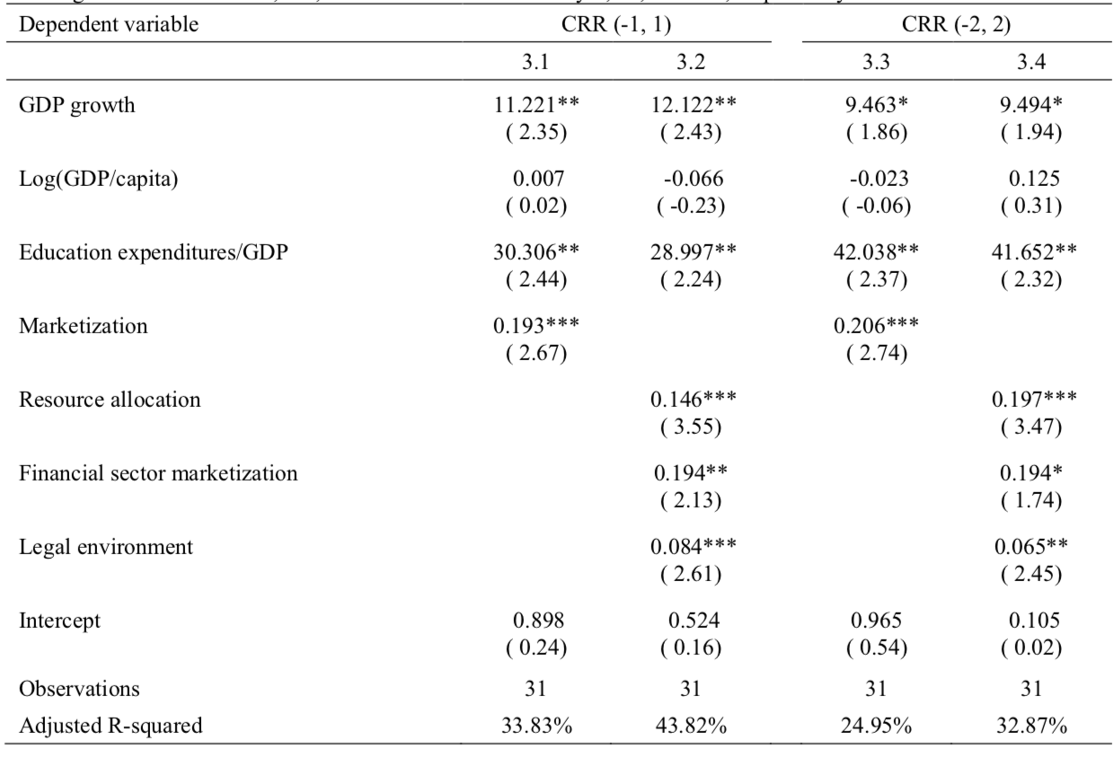
Figure 4: Province Level Portfolio Raw Returns
Notes:
GDP Growth, Education expenditures/GDP
Marketization

Slide 16
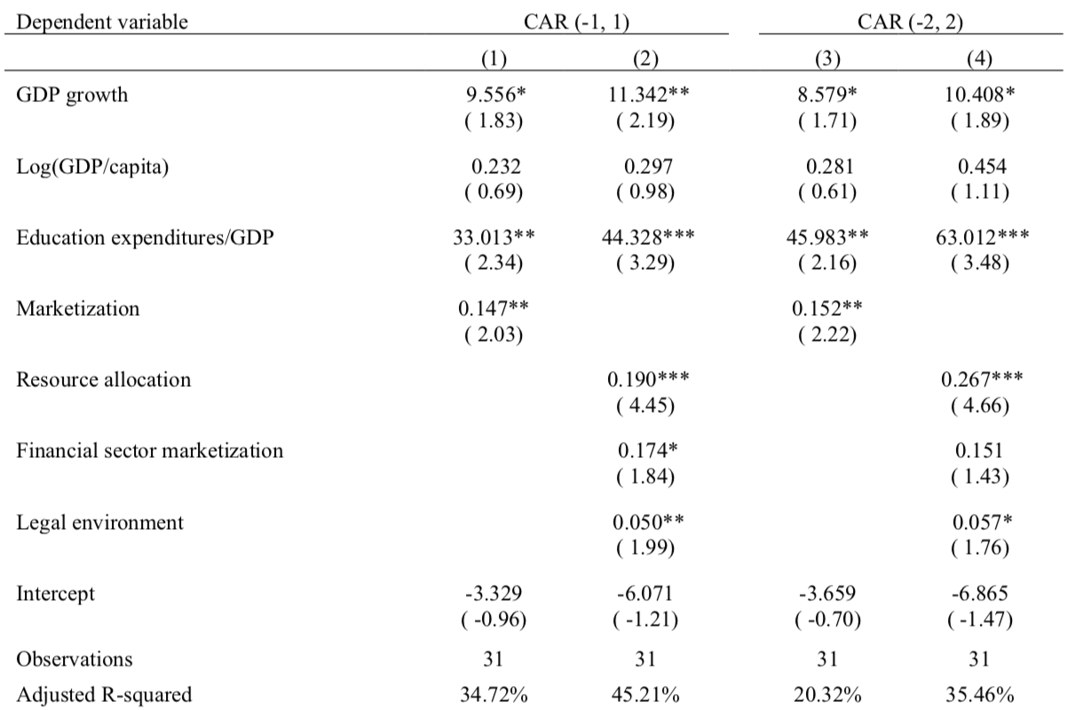
Figure 5: Province Level Portfolio Cumulative Abnormal Returns

Slide 17
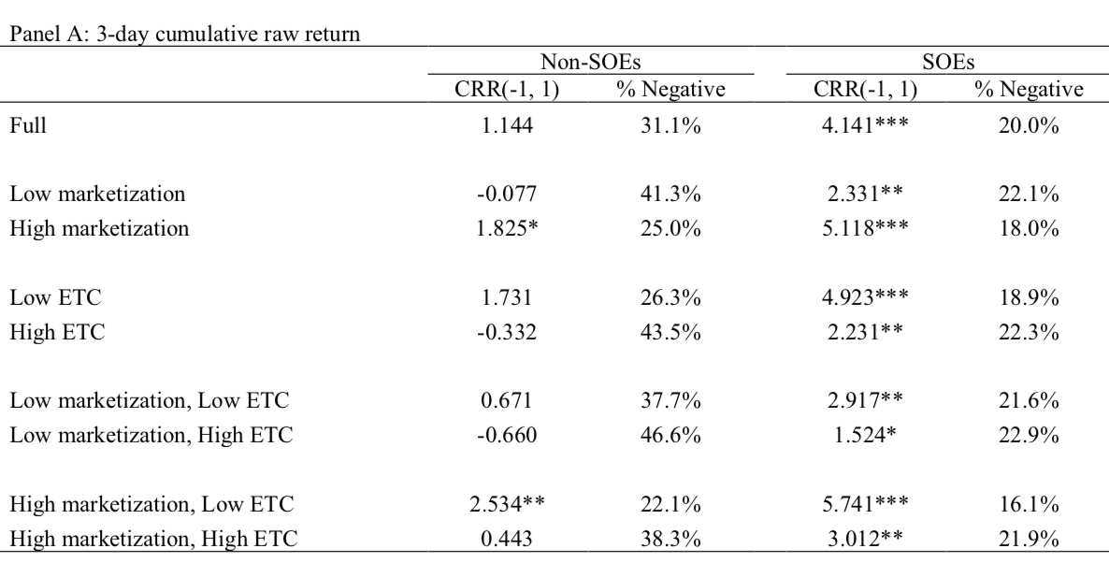
3.3 Market Development, State Control, and Prior Investment in Connections
Figure 6:
Notes:
Return: SOE> NON-SOE (positive but insignificant)
Non-SOE: low marketizaiton negative return
Non-SOE: high ETC negative return
High marketization, low ETC, SOE max value; low marketization, high ETC, NON-SOE min return

Slide 18
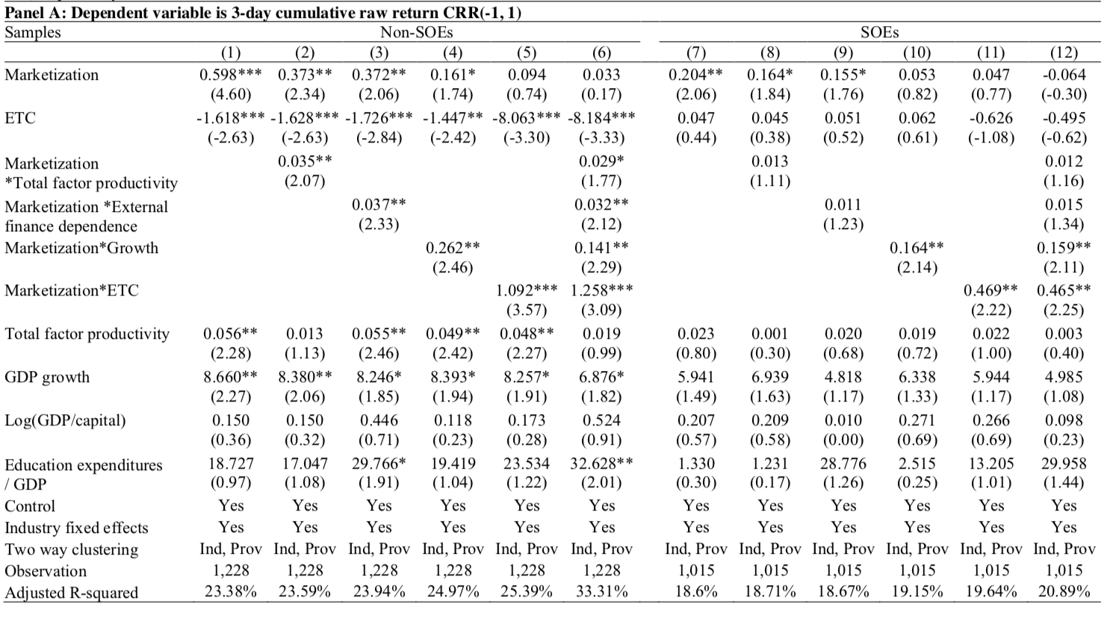
3.4 Firm-level Regressions
Figure 7: Regression Analyses on Firm-level Cumulative Returns

Slide 19
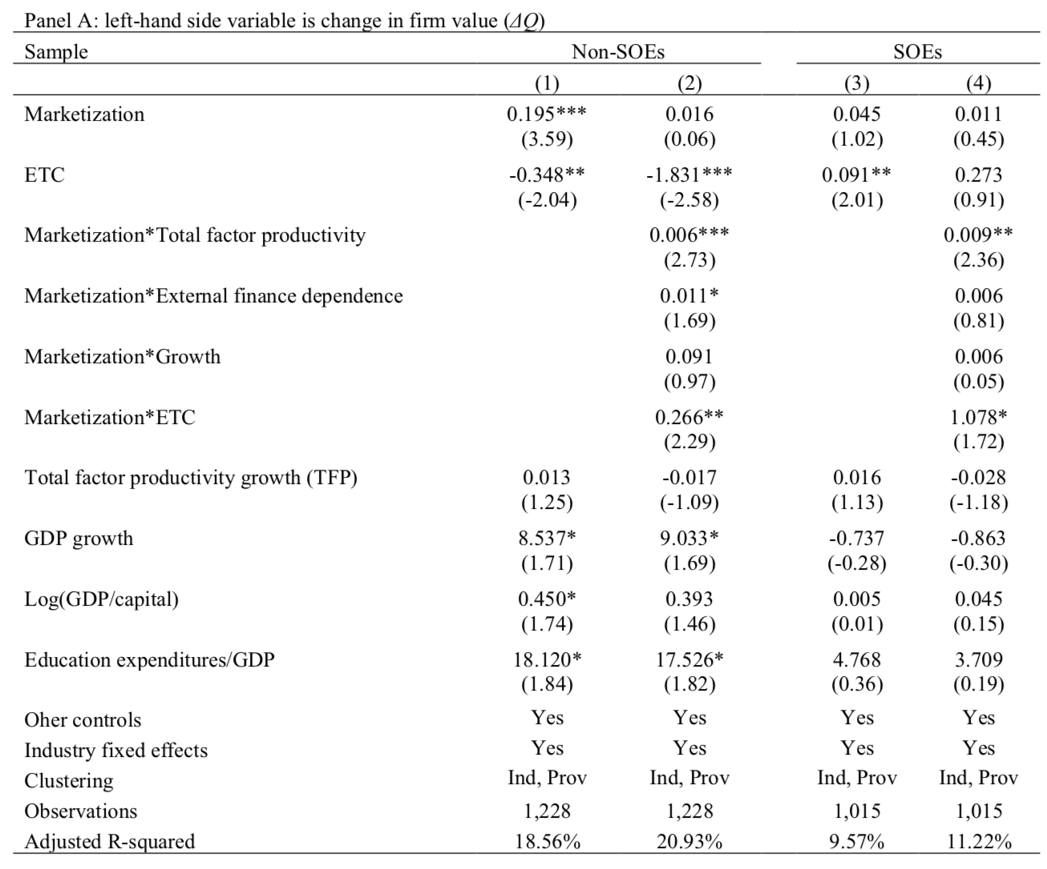
3.5 Change in Firm Performance
Figure 8: Regression Analyses on
change of Tobin’s Q
Notes:
Non-SOE: firms’ valuation ratios rise more if they are based in provinces with more developed market institutions, higher education expenditure and higher past growth
SOE: the coefficient on ETC is significantly positive in Col. 3, and marketization interacted with ETC is also positive and significant.
For change in SG and ROA, similar patterns, similar results.

Slide 20
3.6 Robustness Discussion
Firm-level tests cluster separately
by industry and by province
Exclude observation outliers
Test cumulative return
with H-shares
Exclude special provinces
Marketization’s correlation
with unobservable variables
Drop special industries

Slide 21
Conclusions and Final Thoughts
04

Slide 22
4.1 Statistical Conclusions
1.Overall market reaction is positive
2.Positive effect is more obvious under high marketization situation, GDP growth, and education expenditures/GDP, regardless of SOEs or Non-SOEs.
3.The reaction of SOE and Non-SOE differs.
The reaction is uniformly positive for SOEs, but heterogeneous across non-SOEs. The reaction is more positive for non-SOEs in provinces with more developed market institutions and with higher prior productivity, greater external financing dependence, and greater growth potential.
Prior ETC is positively related to the value of SOEs, but ETC in low marketization is negatively related to the value of Non-SOEs.

Slide 23
4.2 Economic Interpretations
Overall, Chinese investors believe the eight-point regulation is a good news to firm valuation.
Prior pro-market reform may be a necessary condition for anti-corruption reforms to be shareholder value-enhancing.
For Non-SOEs, the operating, financing and investing capability of companies may another necessary condition to benefit from this anti-corruption reforms.
In low marketization, ETC might be used to promote the growth of Non-SOEs in prior years, but in high marketization, ETC is reasonably suspected to be self-consumption no matter which type of companies.

Slide 24
4.2 Final thoughts:
The study only includes listed companies and lacks the information of SMEs, so it may have survivorship bias.
The statistical conclusions are almost intuitively correct. However, some figures are hard to interpret. Figure 9
The methodology is interesting and thoughtful. However, some definitions are still somewhat ambiguous. Eg. ETC
The researchers are supposed to analyze long-term effects.

Slide 25
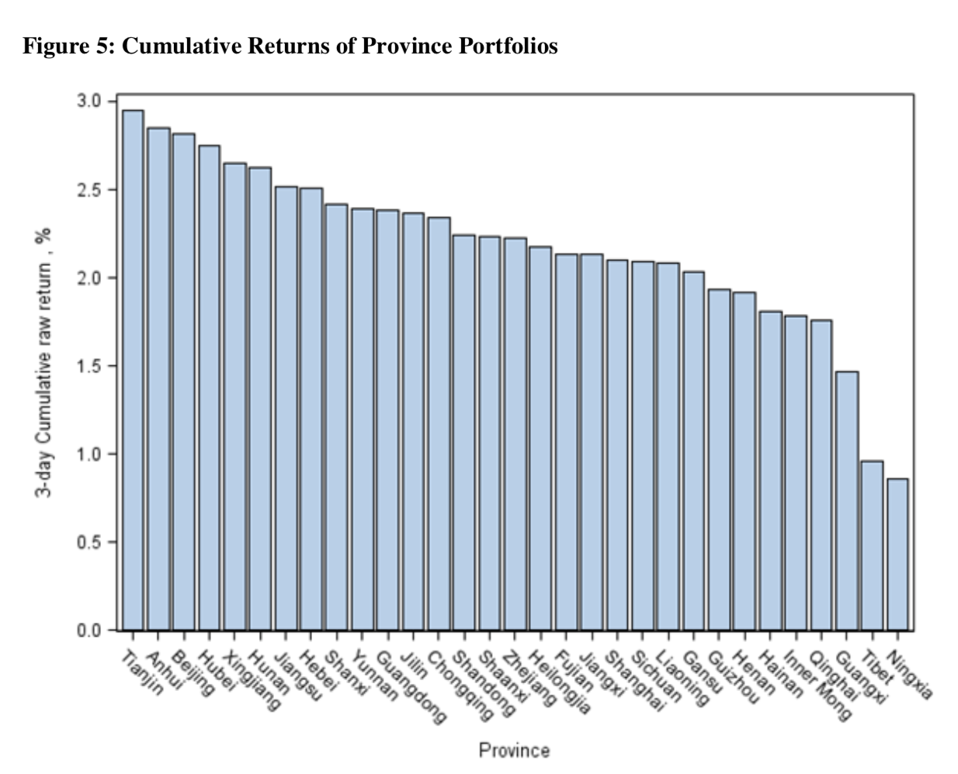
Question:
Back

Slide 26
Thanks for your attention!

